Slide 1
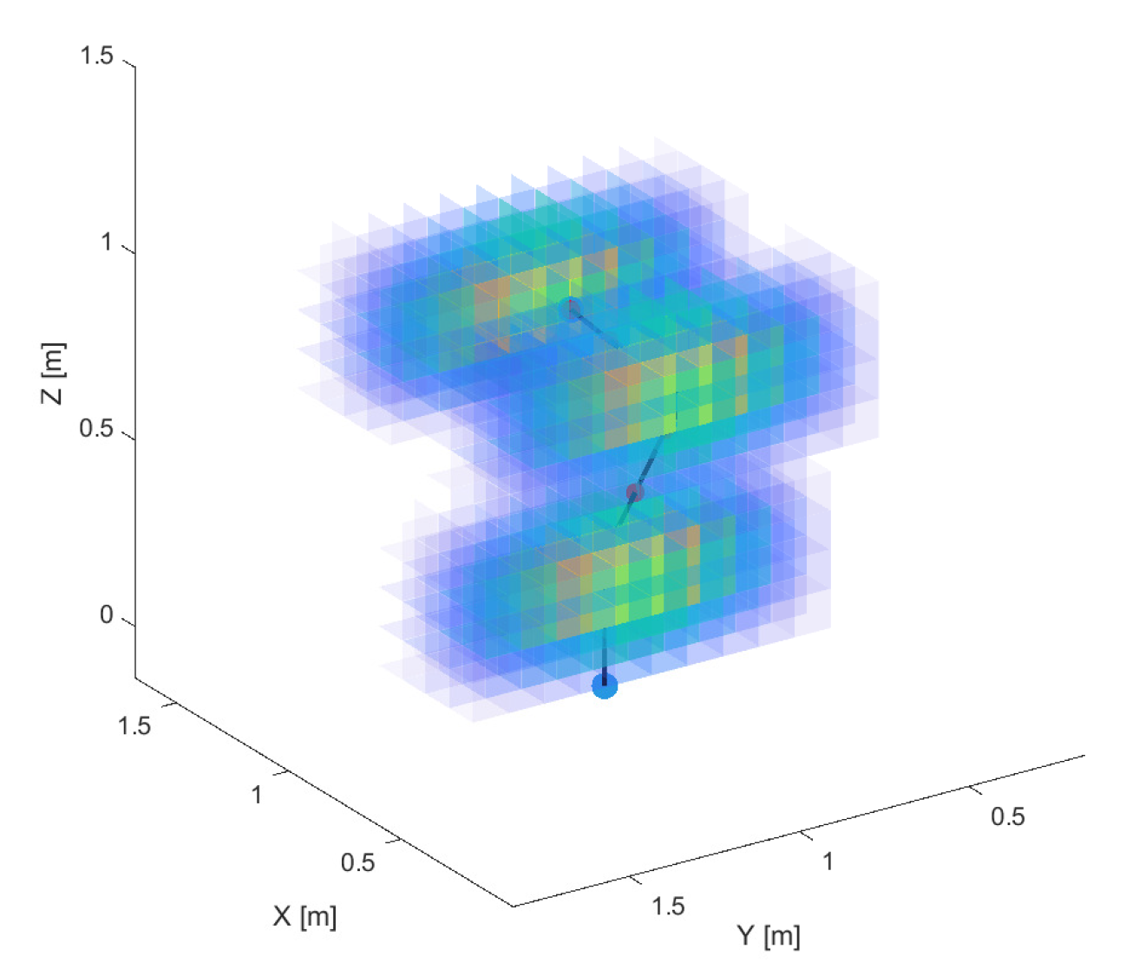
Matrix Multiplication-Driven Repulsive Fields for Manipulator Kinematic Obstacle Avoidance
Jakob Baumgartner
Faculty of Electrical Engineering, University of Ljubljana, Slovenia
Gregor Klančar
Faculty of Electrical Engineering, University of Ljubljana, Slovenia
We propose a new method for repulsive potential field calculation in 3D.
Special 3D convolutional kernels are used for gradient field calculation.
We use tri-linear interpolation for smoothing the discrete gradient field.
The proposed repulsive fields method is implemented for manipulator obstacle avoidance.
Repulsive kernels visualization.

